Slide 1
Week-2
COSC 32001 Computer Vision
Noopa Jagadeesh
Date: 18 Jan 2024

Slide 2
Agenda
Digital Images
Python libraries for image analysis
Basic image processing
Application-Color Recognition using HSV Colorspace

Slide 3
Digital Images

Slide 4
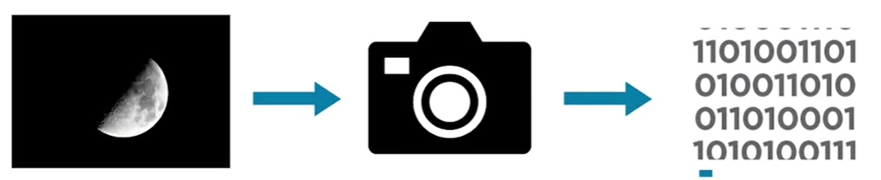
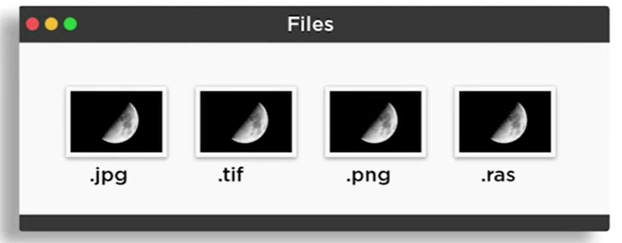
Digital Images
Image processing is used to solve challenging problems in many science and engineering applications.
But before we can process an image in MATLAB or OpenCV, it must be captured and stored in a digital format.
There are different image types we're likely to encounter and they can have different file formats

Slide 5


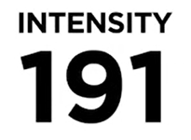
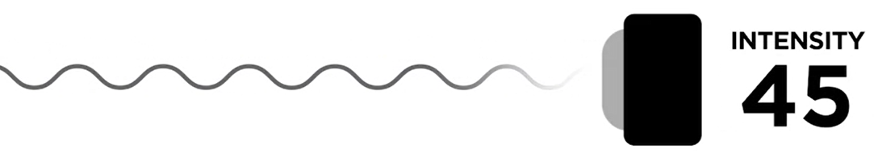
Digital Images
Digital cameras use electronic light receptors.
These receptors use photosensitive materials to convert incoming light waves into electrical signals.
And record the electrical signals as numeric intensity values. Humans perceive intensity as brightness, which is determined by the amplitude of the light.
Monochrome sensors record only intensity values that are used to capture grayscale images.

Slide 6
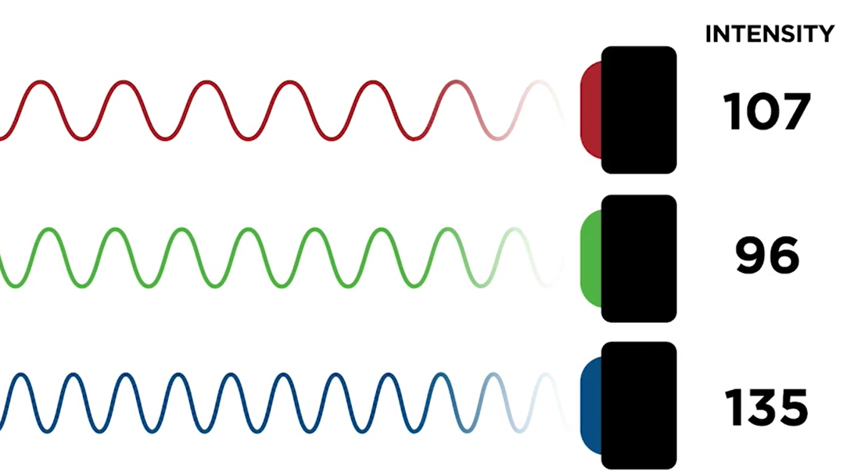
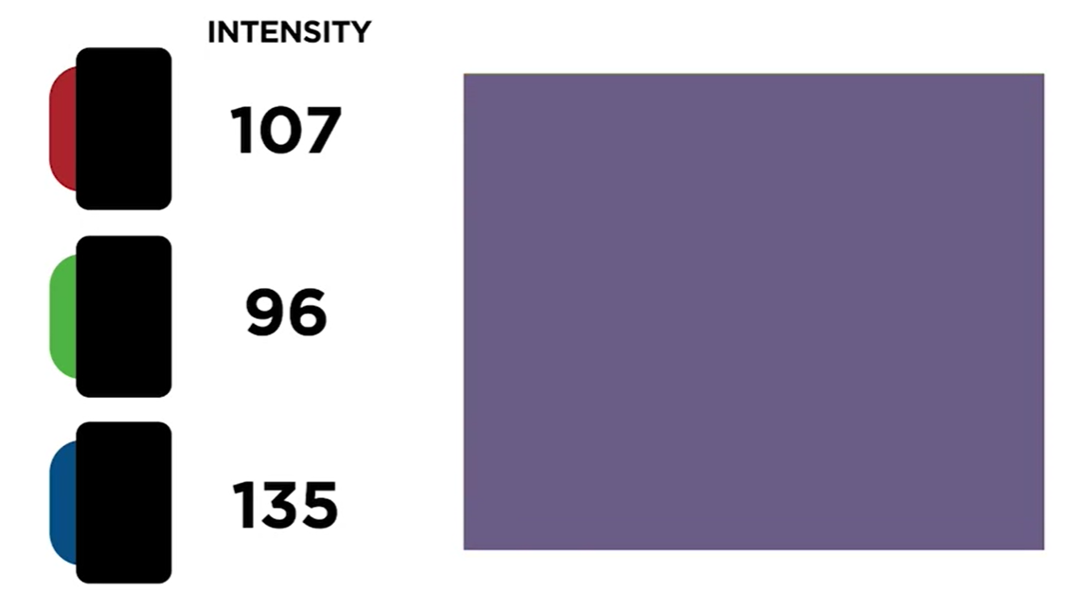
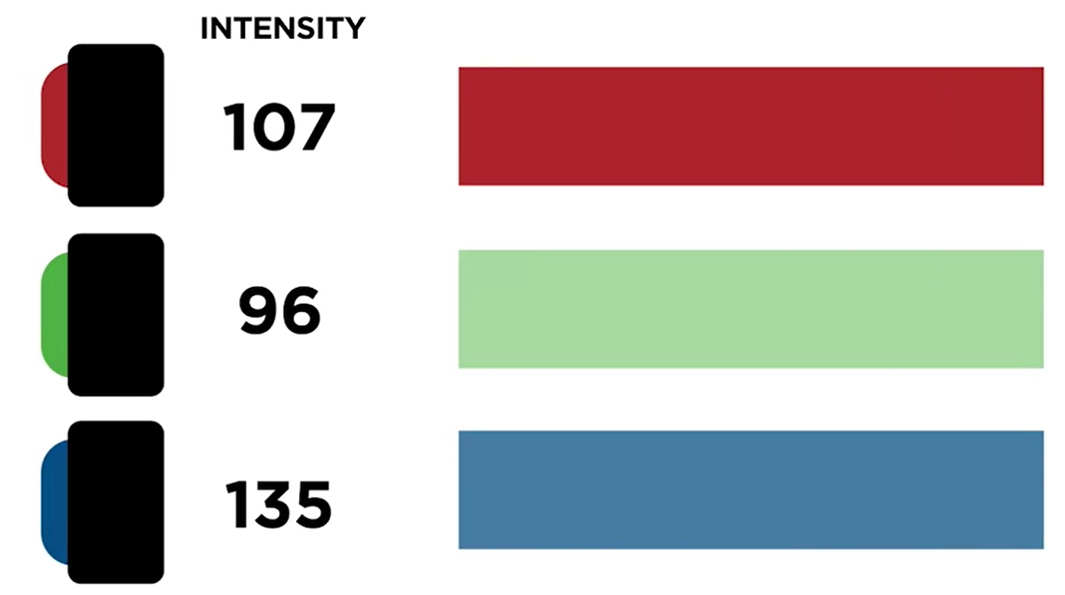
Digital Images
To create color images, multiple sensors are used to record the intensity of incoming light at three different wavelengths, which humans perceive as red, green, and blue.
These color components are called channels.
Channels can be recombined according to their intensities to form the original color.

Slide 7
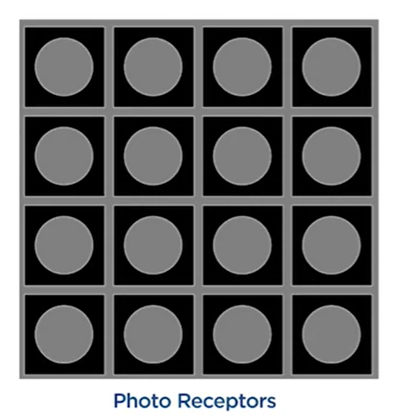
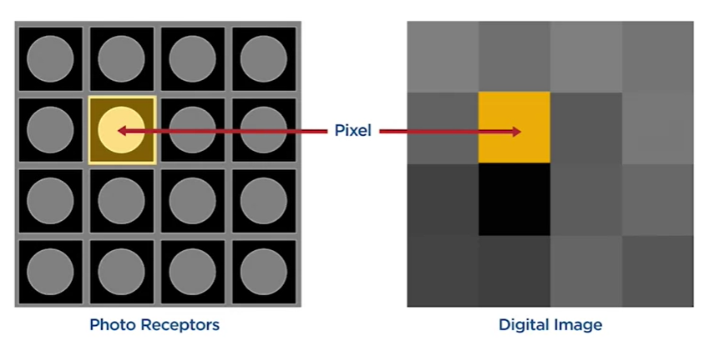
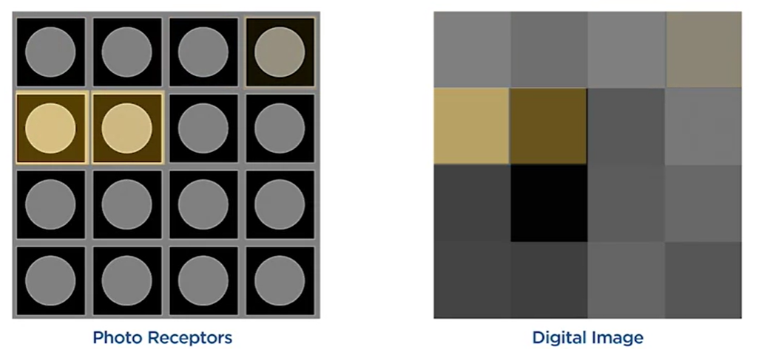
Digital Images
The number of pixels used to form the image is referred to as the image resolution.
Photo receptors are typically organized in a rectangular grid.
The intensity captured by an individual receptor on the grid is referred to as a pixel, where a pixel is the smallest component of a digital image.

Slide 8
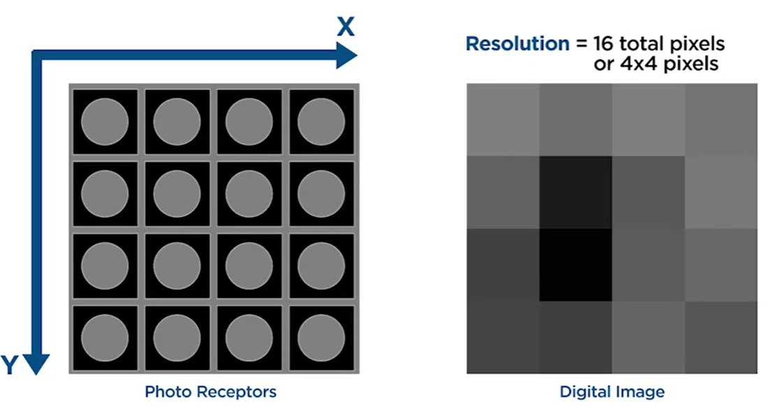
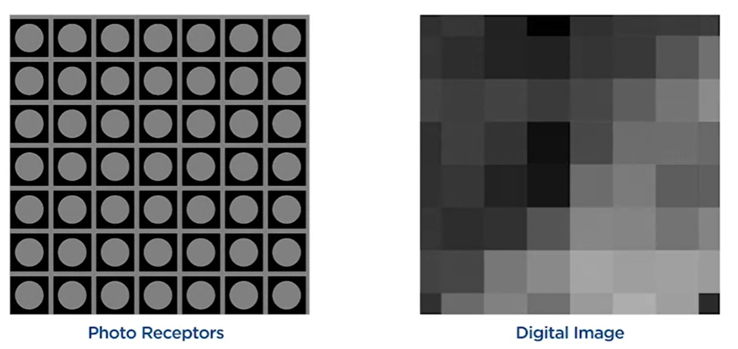
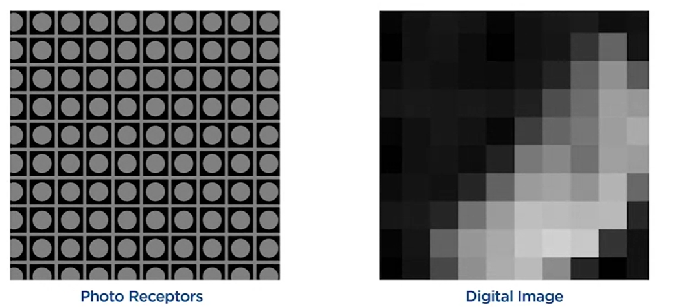
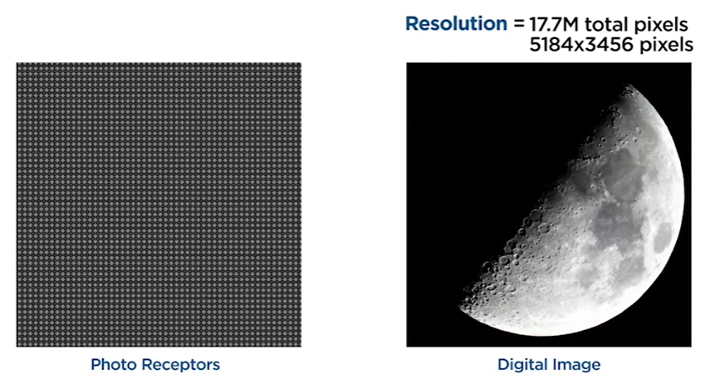
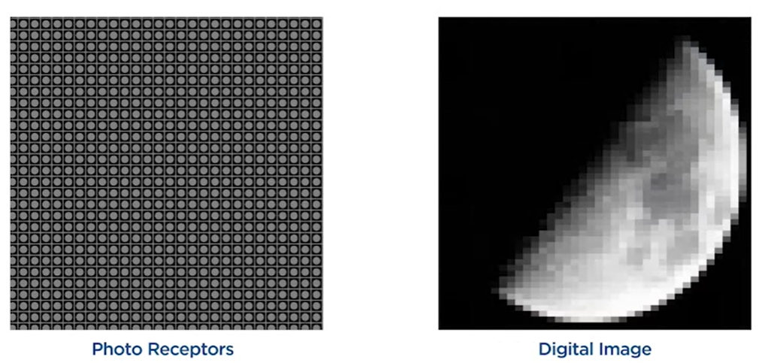
Digital Images
Resolution is commonly expressed as either the total number of pixels or the total number of pixels in the vertical and horizontal directions.
In general, higher resolution images allow for more visual information to be captured, resulting in better quality.

Slide 9
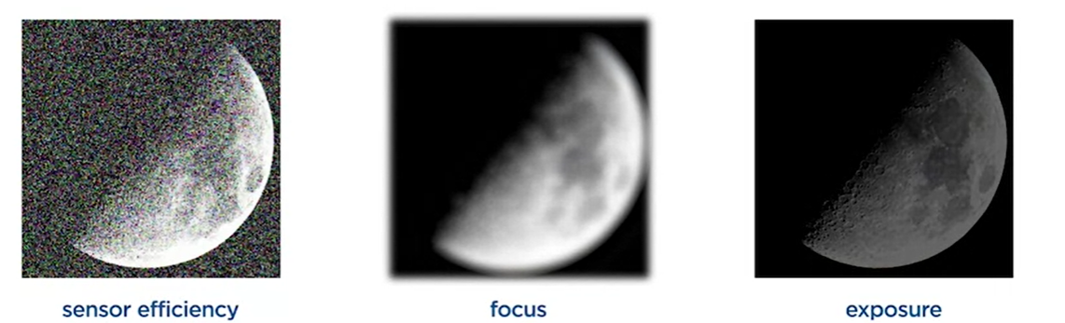
Digital Images
Factors that affect image quality
Exposure, is the amount of light allowed to reach the sensors.

Slide 10
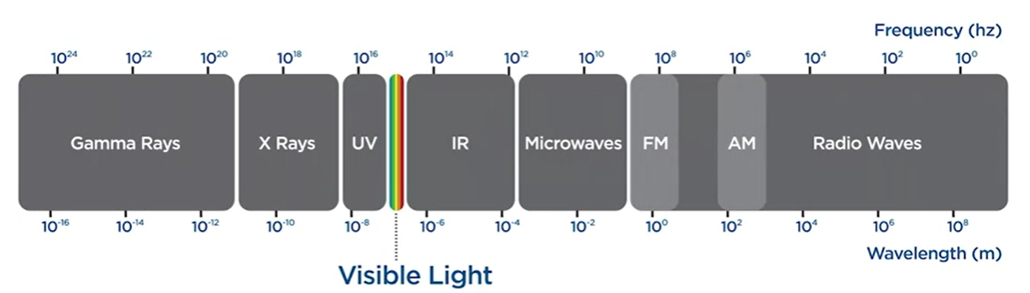
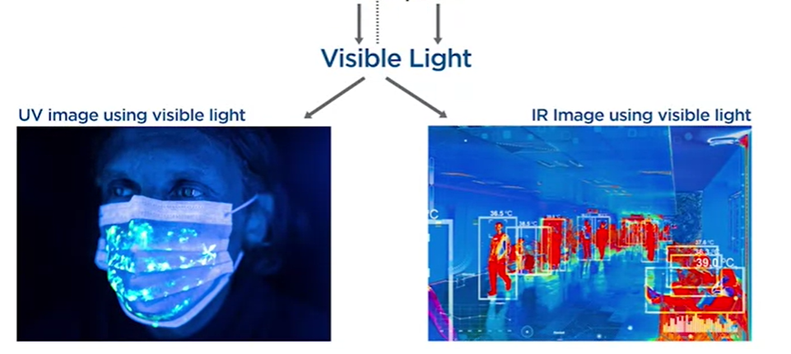
Digital Images
The wavelength of light captured by a camera depends on the type of camera sensor and any filters that might be used.
Most standard digital cameras, like those in smartphones or consumer-grade cameras, are designed to capture light in the visible spectrum, which ranges approximately from 380 to 750 nanometers (nm).
This range corresponds to the wavelengths of light that are visible to the human eye, from violet (shortest wavelength) to red (longest wavelength).
Scientific images are captured using wavelengths which are invisible to the human eye, but detectable by photo receptors, including ultraviolet and infrared. But this intensity information can still be transformed into wavelengths that humans can see.

Slide 11
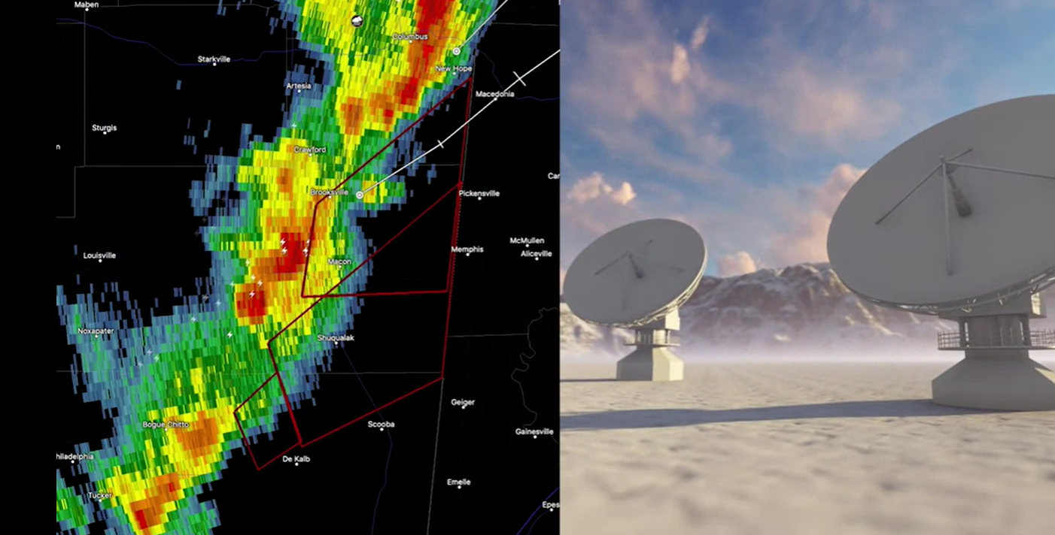
Digital Images
In addition to cameras, image data can be generated from other types of instruments, which represent non-visual information using images.
For example, weather maps are generated using radar signals. Here, the amount of reflected signal detected depends on a number of factors, including how much precipitation is falling.
https://www.weather.gov/mkx/using-radar

Slide 12
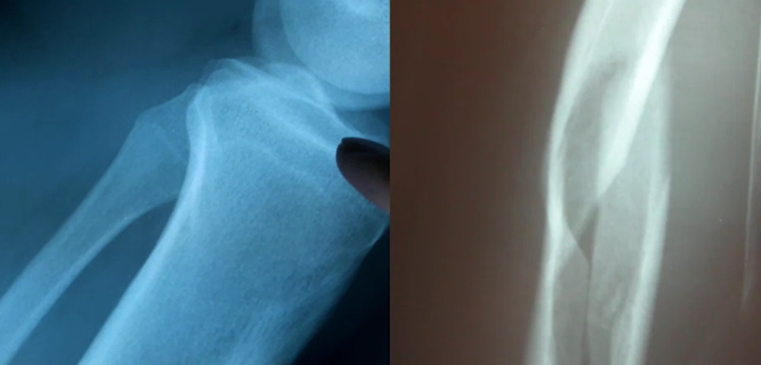
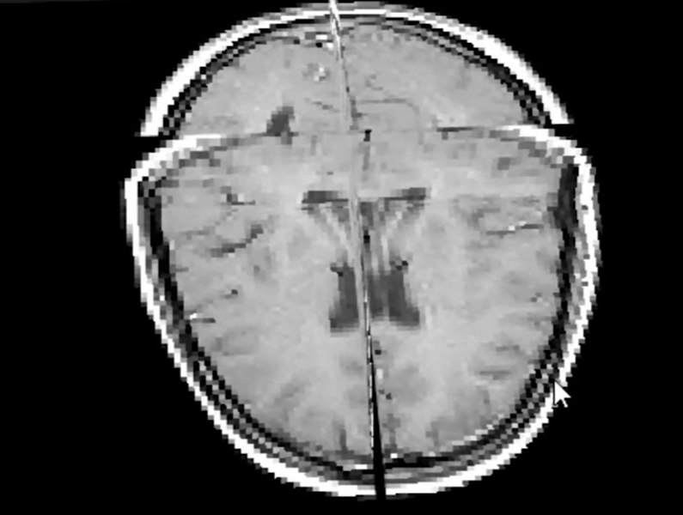
Digital Images
Medical professionals visualize the composition of the human body by taking X-ray images
or using magnetic resonance imaging.
In these professions, it's common to work with 3D images when measurements are taken over a volume.
3D pixels are referred to as voxels.

Slide 13
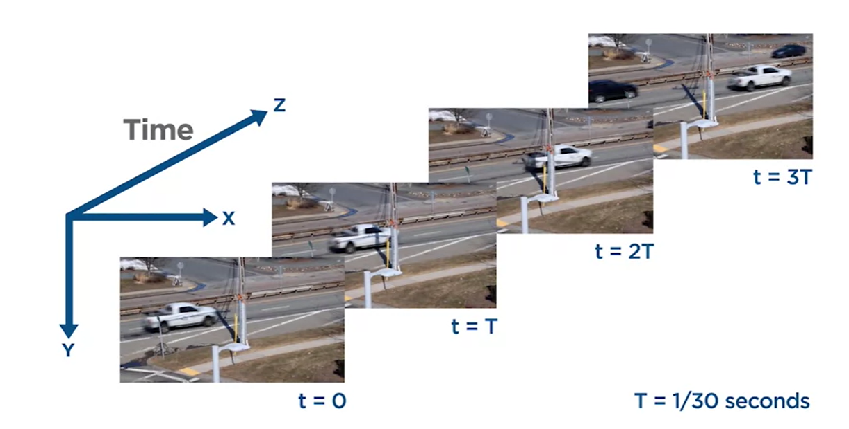
Digital Images
Viewing all the information in a three-dimensional image is challenging, so it's common to select slices of the higher-dimensional data which correspond to the measurements taken on a particular plane or surface.
A type of three-dimensional image we are familiar with is video. As the two-dimensional image frames can be stacked sequentially along an additional dimension representing time.

Slide 14
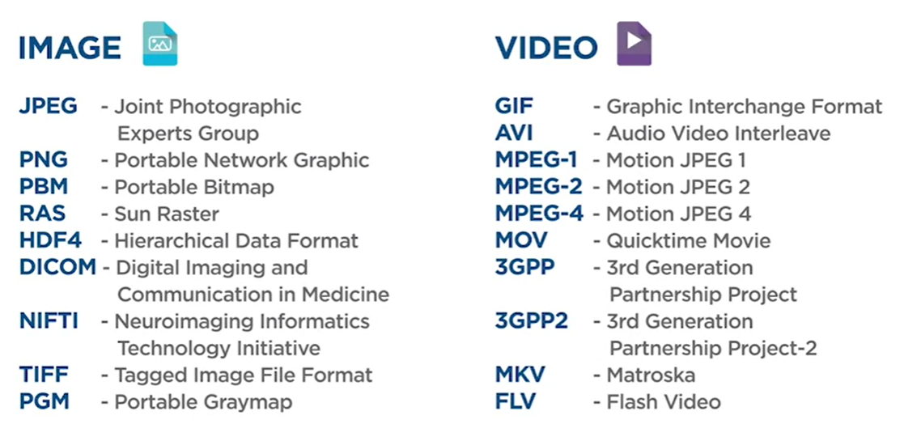
Digital Images
With so many types of digital image data, there are many different ways to store them.
But why so many?
One reason is due to the different possible dimensionalities of image data and whether they represent single images or a sequence of frames. Another reason is that different compression techniques are used with each format.
One other difference between image file types is additional data that may be included in the file. For example, it's common for video data to be coupled with audio data as a multimedia file.
Image, video, and multimedia files also contain additional text information called metadata. Metadata can include the image capture date and location, the device used,
a description of the image, the video frame rate, and other information depending on
the type of image and the file standards.

Slide 15
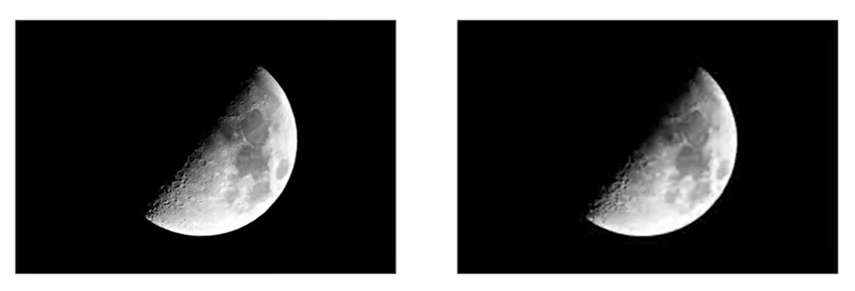
Digital Images
Image Compression
The goal of compression is to try to store the most amount of visual information using the least amount of memory.

Slide 16
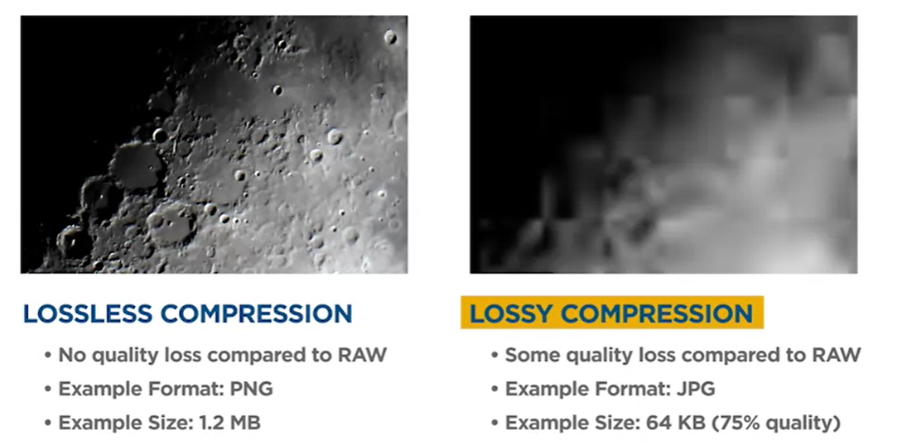
Digital Images
Image Compression

Slide 17
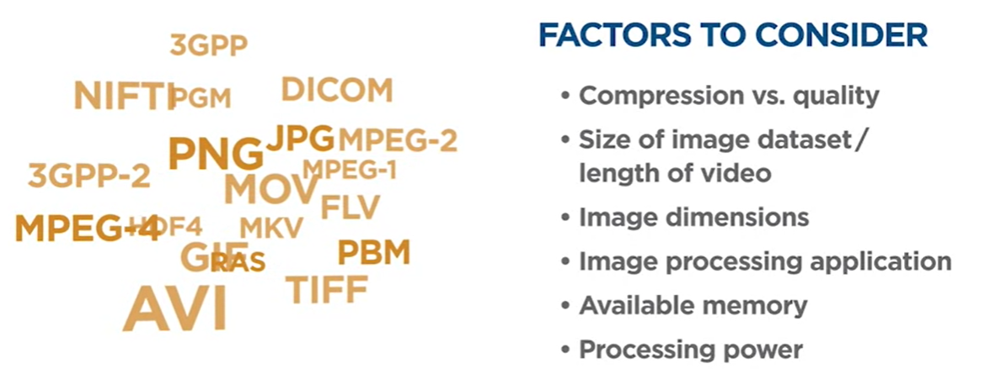
Digital Images
Factors to be considered when choosing file format
Mostly this choice is made for us unless if we plan to capture your own images, or are willing to convert between formats.

Slide 18
Top python libraries for image analysis

Slide 19
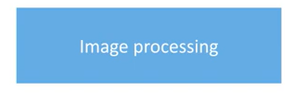

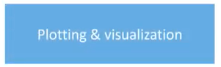
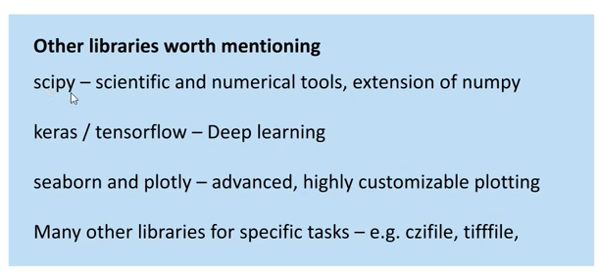
Top 5 python libraries for image analysis
scikit-image
NumPy
Matplotlib
https://numpy.org/
https://matplotlib.org/
https://scikit-image.org/
pandas
OpenCV
https://opencv.org/
https://pandas.pydata.org/

Slide 20


Basic Image Processing using Libraries

Slide 21
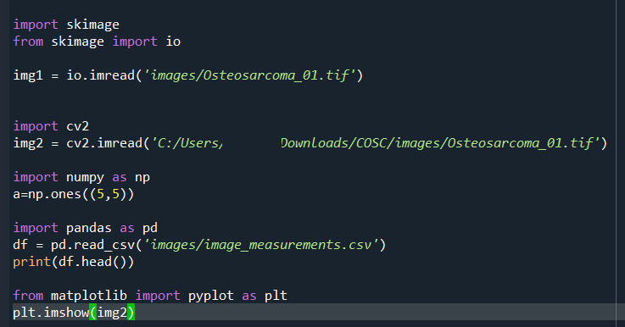
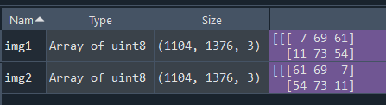
Read an image from a file
OpenCV represent images in BGR channel ordering rather than the standard RGB?
Back when OpenCV was originally developed, BGR ordering was the standard! It was only later that the RGB order was adopted. The BGR ordering is standard in OpenCV.
Notes:
Tennis-ball

Slide 22
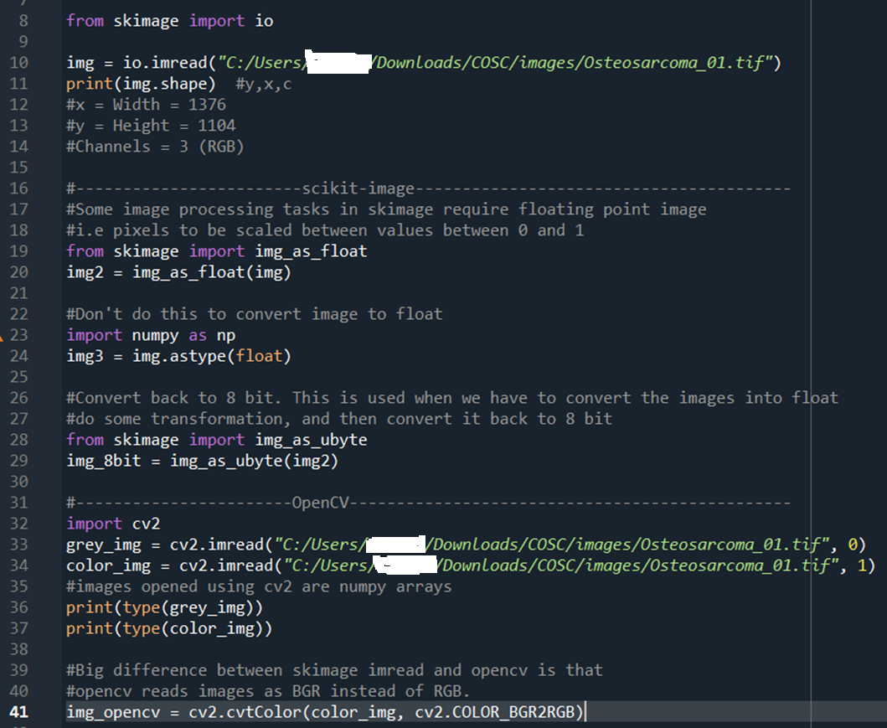
Read an image from a file
The point here is we can read images in scikit-image or OpenCV. Both of these save images as an numpy array, meaning they're ready for us to process.
OpenCV saves images as BGR. As
long as you stick with open CV for your
entire process we won't even notice
that it's BGR and not RGB.
But the problem occurs when we use Open
CV to open images and scikit-image to
perform certain actions and then use
OpenCV to actually save it as an image

Slide 23
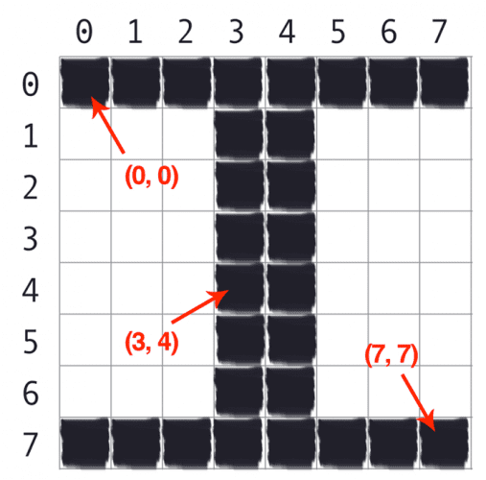
Overview of the image coordinate system in OpenCV
An image is represented as a grid of pixels. Imagine our grid as a piece of graph paper. Using this graph paper, the point (0, 0) corresponds to the top-left corner of the image (i.e., the origin). As we move down and to the right, both the x and y-values increase.
The point at (0, 0) corresponds to the top-left pixel in our image, whereas the point (7, 7) corresponds to the bottom-right corner.
It is important to note that we are counting from zero rather than one. The Python language is zero-indexed, meaning that we always start counting from zero.
Images in OpenCV are represented by NumPy arrays. To access a particular image pixel, all we need to do is pass in the (x, y)-coordinates as image[y, x]

Slide 24
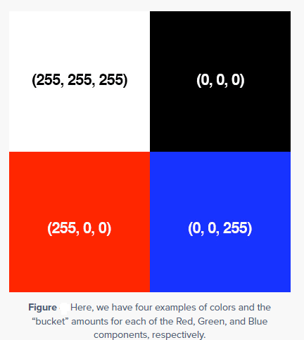
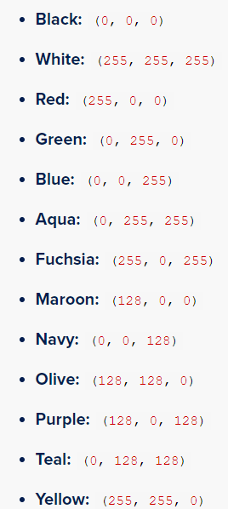
Getting and setting pixels with OpenCV
For reference, here are some common colors represented as RGB tuples:

Slide 25
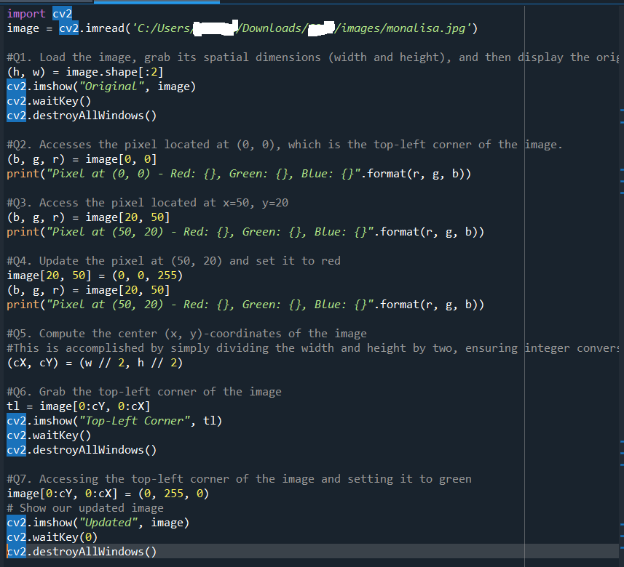
Getting and setting pixels with OpenCV

Slide 26
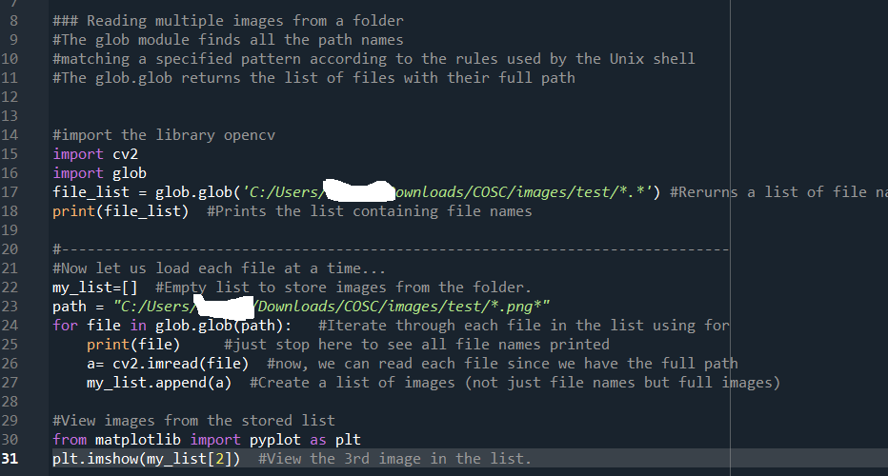
Using glob to read multiple files in python
We often don't do image processing
on a single image. Most of the time we
want to apply whatever we do on the
single image on to a whole bunch of images.
The way we do that is by reading all these image files into Python and then applying certain function to them or certain operation to them.

Slide 27
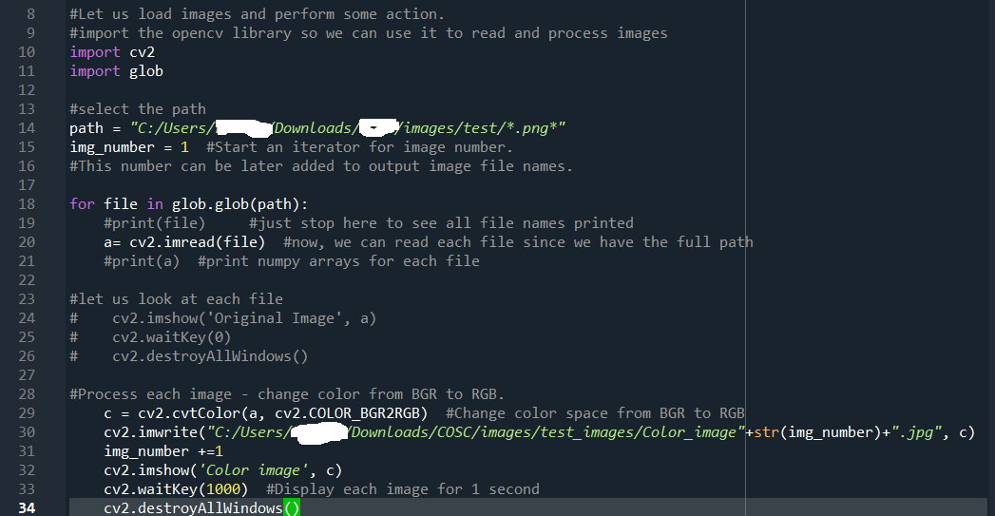
Using glob to read multiple files in python
Notes:
Channel swap

Slide 28
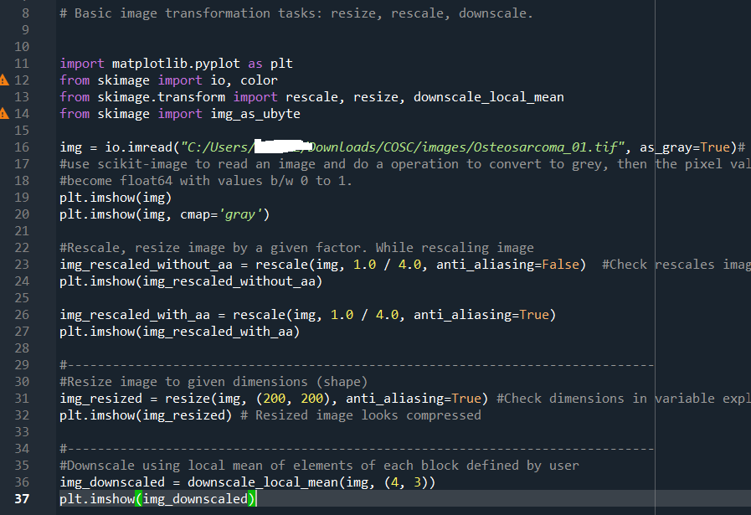
Basic image processing using scikit-image library
Anti-aliasing is a crucial technique applied during image rescaling (resizing) to address an issue known as aliasing. Aliasing occurs when high-resolution images are reduced to lower resolutions, or when images are rendered at a resolution that is insufficient to capture fine details.
This can result in visual artifacts such as jagged edges (often referred to as "jaggies") on diagonal lines and curves, and a general loss of clarity, especially around edges and in detailed patterns.
The downscale_local_mean function divides the image into blocks of size 4x3 pixels (in this example), calculates the mean color value of the pixels within each block, and then replaces the entire block with the mean color value. This process results in a smaller image where each pixel represents the average color of the original pixels in its block.
Notes:
The rescale function from skimage. is used to resize the image. The factor 1.0/4.0 reduces the size of the image to 25% of its original dimensions.

Slide 29
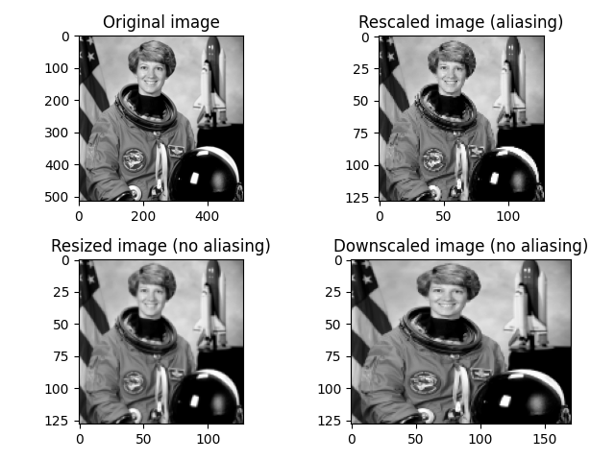
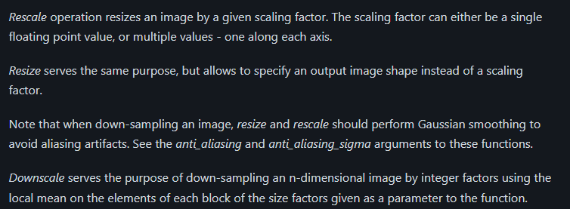
Rescale, Resize, and Downscale
https://scikit-image.org/docs/stable/auto_examples/transform/plot_rescale.html

Slide 30
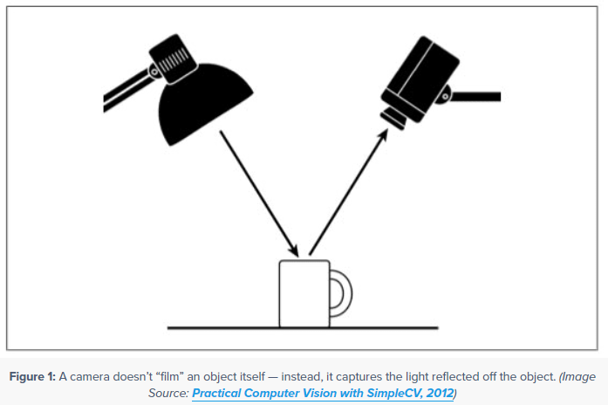
OpenCV Color Spaces ( cv2.cvtColor )
Four color spaces/models in OpenCV:
RGB
HSV
L*a*b*
Grayscale
Lighting conditions in very important in image processing and computer vision
The quality of light in a given environment is absolutely crucial in obtaining our goals.

Slide 31
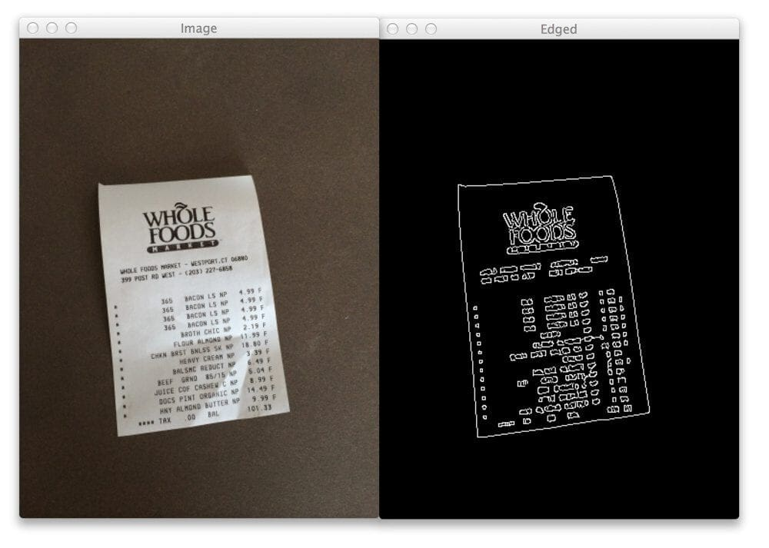
OpenCV Color Spaces
The camera is not actually “filming” the object itself. Instead, it is capturing the light reflected from our object. This also implies that different objects in images will require different lighting conditions to obtain “good” results (where “good” is defined in terms of whatever the end goal of your algorithm is).
In general, your lighting conditions should have three primary goals.
Goal #1: High contrast
You should seek to maximize the contrast between the Regions of Interest in your image (i.e., the “objects” you want to detect, extract, describe, classify, manipulate, etc., should have sufficiently high contrast from the rest of the image so they are easily detectable).
For example, when building our simple document scanner we ensured that the piece of paper we wanted to detect was light on a dark background, thereby ensuring there is sufficient contrast and the paper can be easily detected:

Slide 32
OpenCV Color Spaces
Goal #2: Generalizable
Your lighting conditions should be consistent enough that they work well from one object to the next.
If our goal is to identify various United States coins in an image, our lighting conditions should be generalizable enough to facilitate coin identification, whether we are examining a penny, nickel, dime, or quarter.
Goal #3: Stable
Having stable, consistent, and repeatable lighting conditions is the holy grail of computer vision application development. However, it’s often hard (if not impossible) to guarantee — this is especially true if we are developing computer vision algorithms that are intended to work in outdoor lighting conditions.
As the time of day changes, clouds roll in over the sun, and rain starts to pour, our lighting conditions will obviously change.

Slide 33
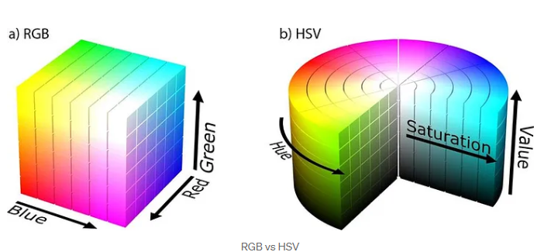
Application-Color Recognition in Real Time using HSV Colorspace
The standard way to store images is RGB, but there are other color spaces like HSV that can be useful in some cases.
The RGB color management can be a disadvantage because it only mixes the primary colors and defines the presence of each by showing the resulting color. What happens if the amount of light color changed?
We simply would get usable results in real life, for these reasons we use the HSV color format.
With HSV, simple color recognition can be used to identify with color with good fidelity compared to BGR. HSV means:
Hue - choose the color
Saturation - color density
Value - brightness of color

Slide 34
Application-Color Recognition in Real Time using HSV Colorspace
Hue: Which “pure” color we are examining. For example, all shadows and tones of the color “red” will have the same Hue.
Saturation: How “white” the color is. A fully saturated color would be “pure,” as in “pure red.” And a color with zero saturation would be pure white.
Value: The Value allows us to control the lightness of our color. A Value of zero would indicate pure black, whereas increasing the value would produce lighter colors.
It’s important to note that different computer vision libraries will use different ranges to represent each of the Hue, Saturation, and Value components.
In the case of OpenCV, images are represented as 8-bit unsigned integer arrays. Thus, the Hue value is defined as the range [0, 179] (for a total of 180 possible values.

Slide 35
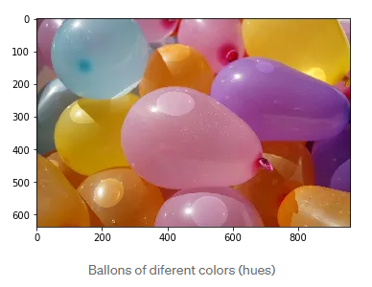
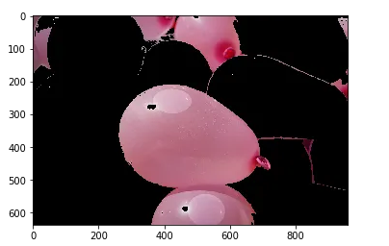
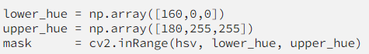
Application-Color Recognition in Real Time using HSV Colorspace
Segmentation
It is very easy to segment a given color if we select the range of Hue that we are interested, for example, the pink:
First we need to convert to HSV color space, this can be done with OpenCV:
cv2.cvtColor(image, cv2.COLOR_RGB2HSV)
Then we define our hue range, (note that OpenCV hue range goes from 0 to 180).

Slide 36
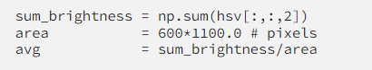
Application-Color Recognition in Real Time using HSV Colorspace
Classification
Other application, of the HSV color space can be the day/night classification depending on the average Value, (amount of light).
If the average is greater than 120 for example, is a day image, otherwise, a night image.

Slide 37
Disclaimer
Due to nature of the course, various materials have compiled from different open source resources with some moderation. I sincerely acknowledge their hard work and contribution

Slide 38


